Slide 1
Project on Exploratory Data Analysis
Done by:
Ashish Kumar Pathak (41221028)
Nitish Tiwari (41221107)

Slide 2
Project Title: Diwali Sales Data Analysis

Slide 3
Objectives:
Libraries Used
About Seaborn
Data Acquisition and Basic Properties Checking
Performing Data Cleaning
Performing Exploratory Data Analysis
Insights Summarization
Conclusion

Slide 4
Introduction

Slide 5
Seaborn library
Seaborn is a Python data visualization library built on top of Matplotlib.
It provides a high-level interface for creating aesthetically pleasing and informative statistical graphics.
Key Features of Seaborn:
a. Easy-to-Use API
b. Beautiful Default Styles
c. Statistical Plotting
d. Integration with Pandas

Slide 6
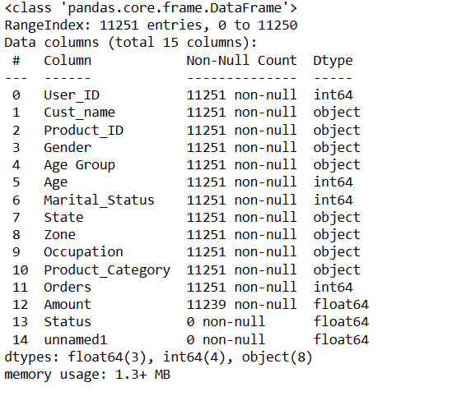

Data Acquisition and properties checking
Reading data from csv file
(df = pd.read_csv('D:\DATA SCIENCE\Project\Diwali Sales Data.csv', encoding= 'unicode_escape’ )
Checking the shape of data set
df.shape
Check data set info.

Slide 7
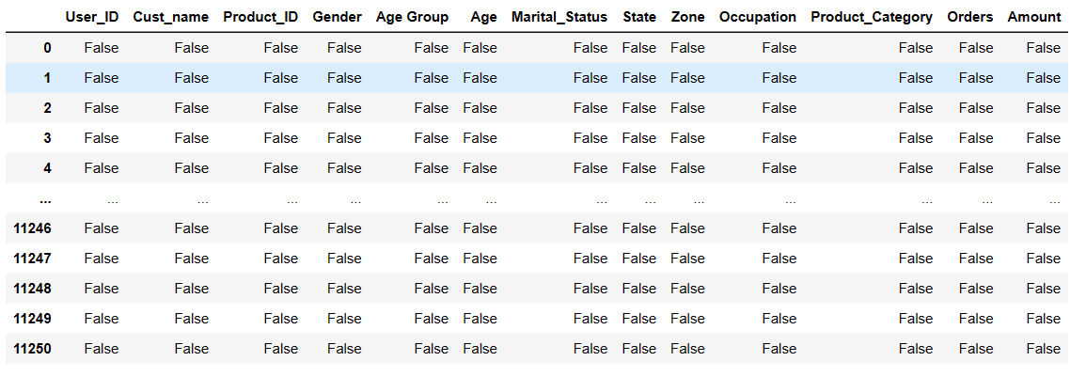
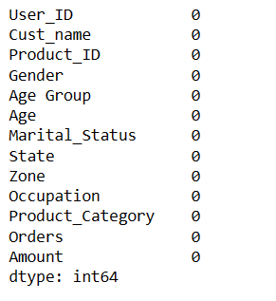
Data Cleaning
Checking null values using isnull()
dropping the null values using dropna
df.dropna(inplace=True)
Checking null values after dropping nulls
pd.isnull(df).sum()

Slide 8
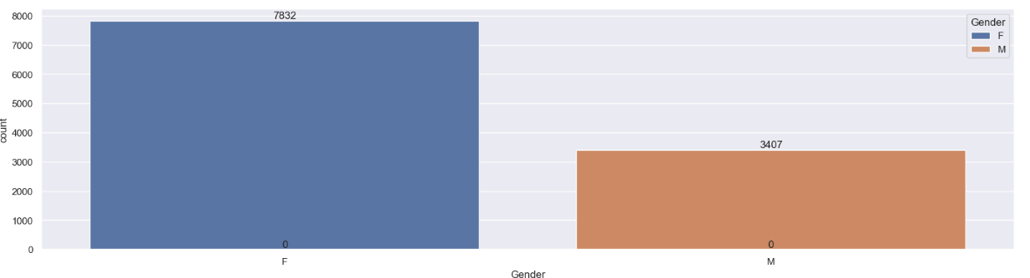
EDA (EXPLORATORY DATA ANALYSIS)
ON THE BASIS OF GENDER
# plotting a bar chart for Gender and it's count
ax = sns.countplot(x = 'Gender',hue="Gender", dodge=False, data = df)
for bars in ax.containers:
ax.bar_label(bars)
INSIGHTS
*From above graphs we can see that most of the buyers are females and even the purchasing power of females are greater than men*

Slide 9
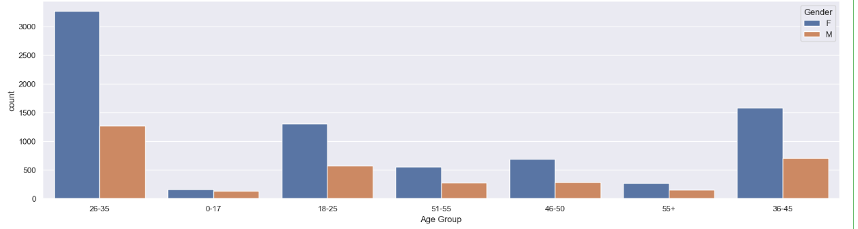
EDA (EXPLORATORY DATA ANALYSIS)
ON THE BASIS OF AGE GROUP
ax = sns.countplot(data = df, x = 'Age Group',hue="Gender")
INSIGHTS
*From above graphs we can see that most of the buyers are of age group between 26-35 yrs female*

Slide 10
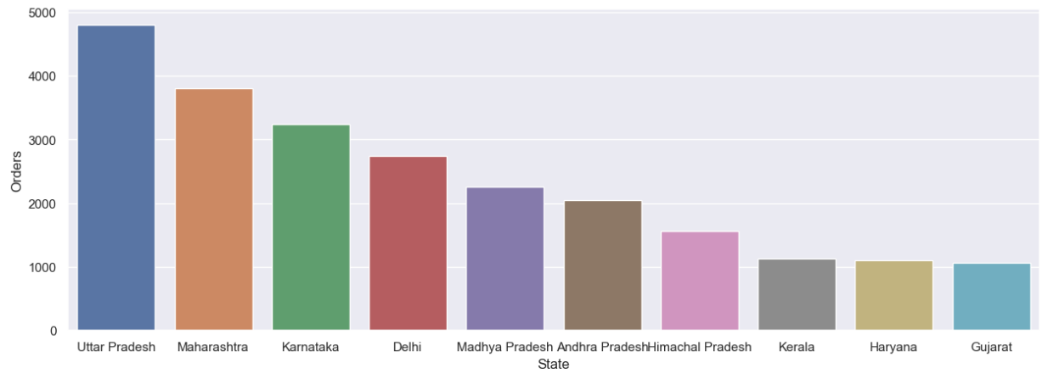
EDA (EXPLORATORY DATA ANALYSIS)
ON THE BASIS OF STATE
# total number of orders from top 10 states
sales_state = df.groupby(['State'], as_index=False)['Orders'].sum().sort_values(by='Orders', ascending=False).head(10)
sns.set(rc={'figure.figsize':(15,5)})
sns.barplot(data = sales_state, x = 'State',y= 'Orders’)
INSIGHTS
*From above graphs we can see that most of the orders & total sales/amount are from Uttar Pradesh, Maharashtra and Karnataka respectively*

Slide 11
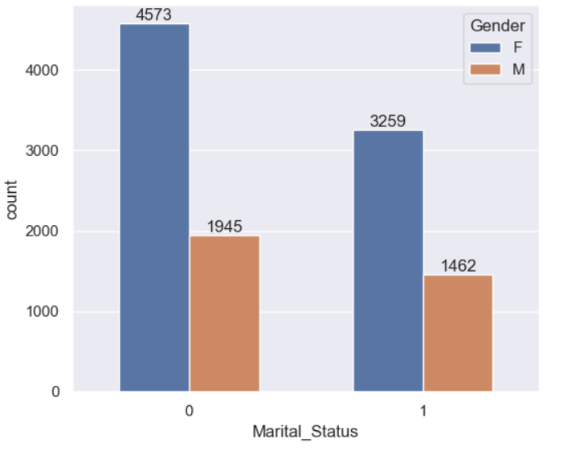
EDA (EXPLORATORY DATA ANALYSIS)
ON THE BASIS OF Marital StatuS
ax = sns.countplot(data = df, x = 'Marital_Status',hue="Gender", width=0.6)
sns.set(rc={'figure.figsize':(6,5)})
for bars in ax.containers:
ax.bar_label(bars)'State',y= 'Orders’)
INSIGHTS
*From above graphs we can see that most of the orders & total sales/amount are from Uttar Pradesh, Maharashtra and Karnataka respectively*

Slide 12
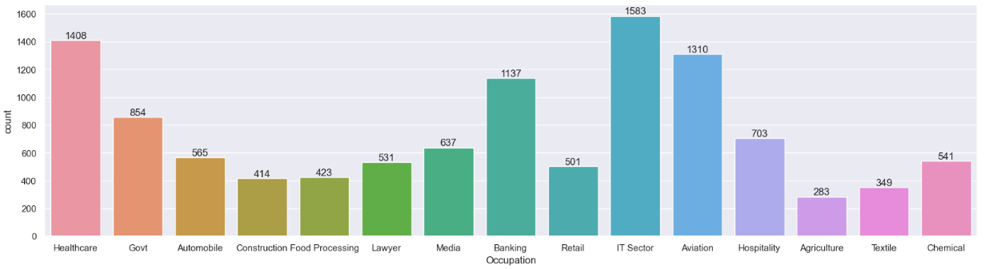
EDA (EXPLORATORY DATA ANALYSIS)
ON THE BASIS OF OCCUPATION
sns.set(rc={'figure.figsize':(20,5)})
ax = sns.countplot(data = df, x = 'Occupation')
for bars in ax.containers:
ax.bar_label(bars)
INSIGHTS
*From above graphs we can see that most of the buyers are working in IT, Healthcare and Aviation sector*

Slide 13
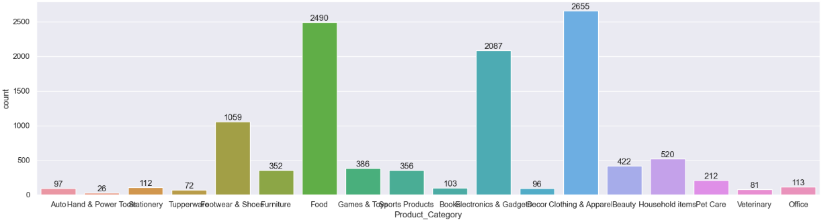
EDA (EXPLORATORY DATA ANALYSIS)
ON THE BASIS OF Product Category
sns.set(rc={'figure.figsize':(20,5)})
ax = sns.countplot(data = df, x = 'Product_Category')
for bars in ax.containers:
ax.bar_label(bars)
INSIGHTS
*From above graphs we can see that most of the sold products are from Food, Clothing and Electronics category*

Slide 14
Insights Summary:
Gender:
Most of the buyers are females and even the purchasing power of females are greater than men
Age:
Most of the buyers are of age group between 26-35 yrs female
State:
Most of the orders & total sales/amount are from Uttar Pradesh, Maharashtra and Karnataka respectively
Marital Status:
Most of the buyers are married (women) and they have high purchasing power
Occupation:
Most of the buyers are working in IT, Healthcare and Aviation sector

Slide 15
Conclusion
*Married women age group 26-35 yrs from UP, Maharastra and Karnataka working in IT, Healthcare and Aviation are more likely to buy products from Food, Clothing and Electronics category*

Slide 16
References
Kaggle.com
Satckoverflow
Python.org
chat.openai.com

Slide 17
THANK YOU

